Slide 1
3D SoC FPGA Project
Cameron Anderson

Slide 2
Overview
Nexys 4 DDR
Process
UART/SPI Code
Mistakes/Lessons Learned
Future Development
Questions

Slide 3
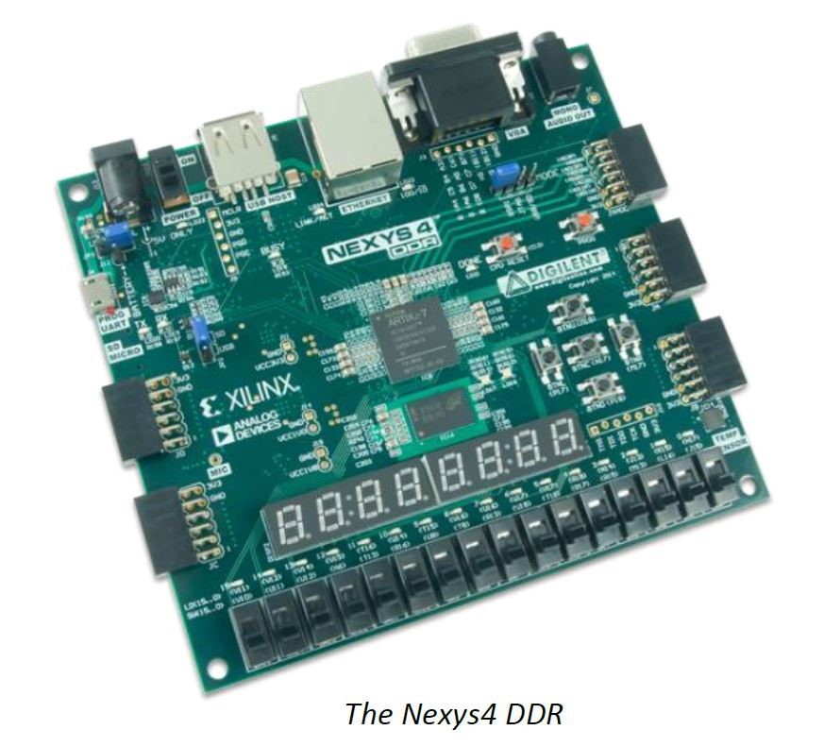
Nexys 4 DDR
Xilinx Artix-7 FPGA
Microblaze Processor
Many ports and peripherals
Notes:
Multiple switches and LEDs, VGA and PWM Audio outputs, Micro SD card connector, 3-axis accelerometer, Temperature sensor, Ethernet, 128MiB DDR2, UART, ADC, among others

Slide 4
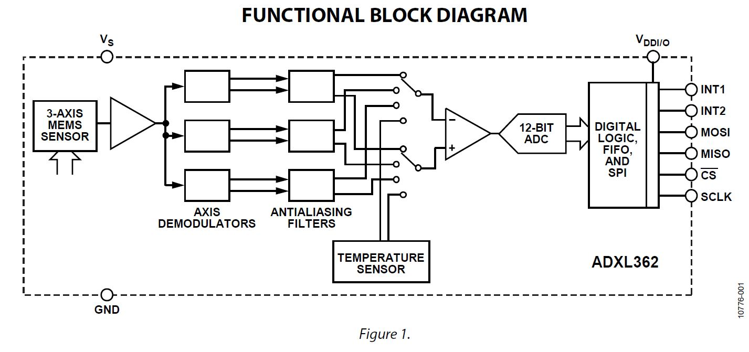
ADXL362 3-Axis MEMS Accelerometer
SPI bus
12 bits/axis
Low Power
FIFO functionality
Interrupts (not used)
Notes:
The ADXL362 is a built-in Digital Accelerometer. It has an SPI digital interface for interfacing with the processor.

Slide 5


Vision/Process
Hardware
Drivers
UART, SPI
Wrappers
Generate Bitstream
Software
Hardware Specs
Board Support Package
Application Program
Programming
ELF file
MATLAB

Slide 6
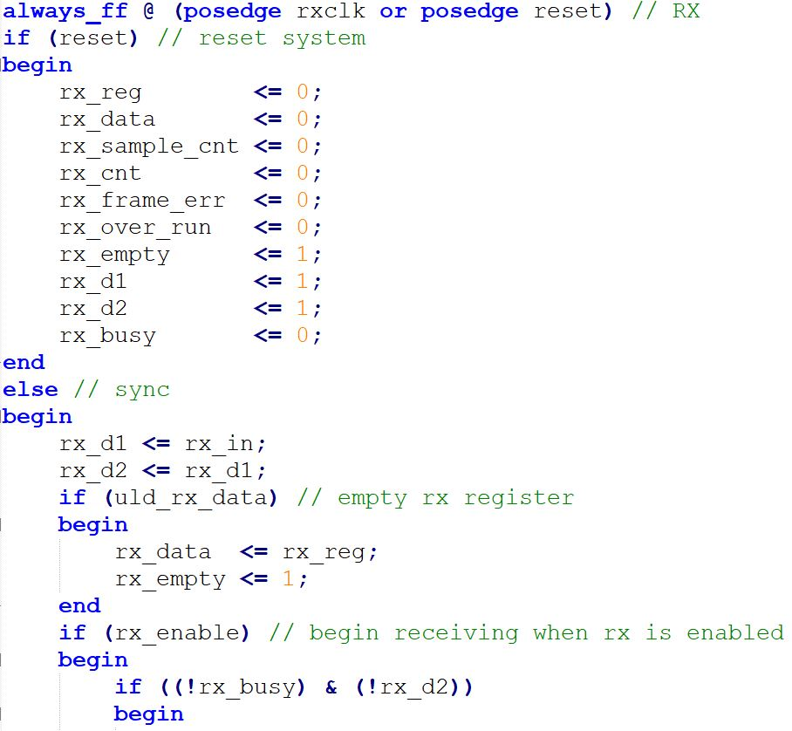
UART Driver (1st iteration)

Slide 7
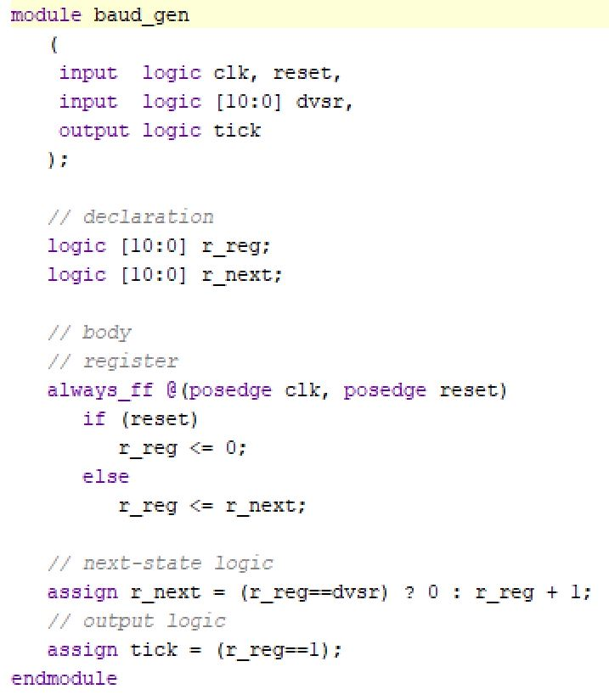
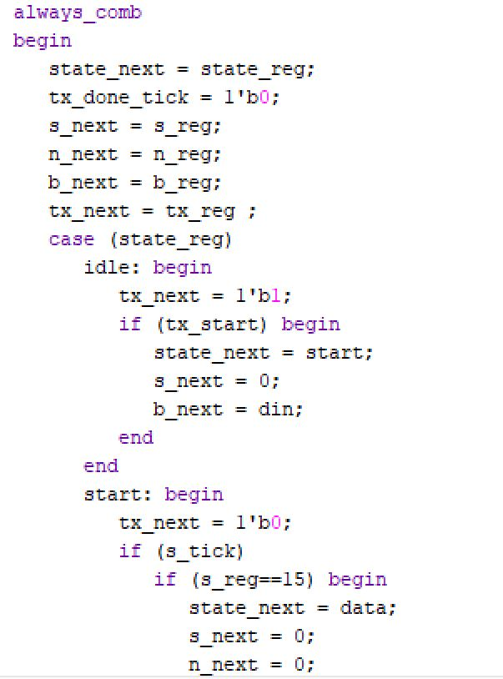
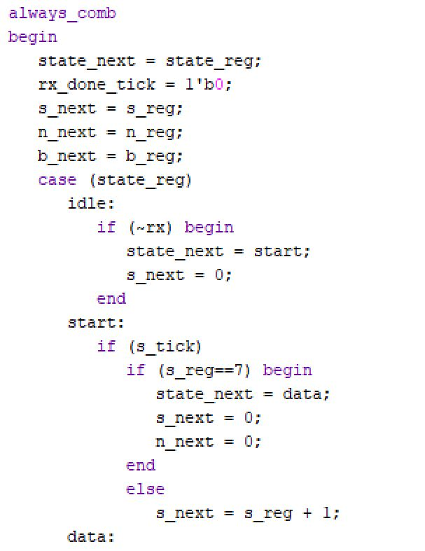
UART Drivers (Chu)
Baud Rate Generator
TX
RX

Slide 8
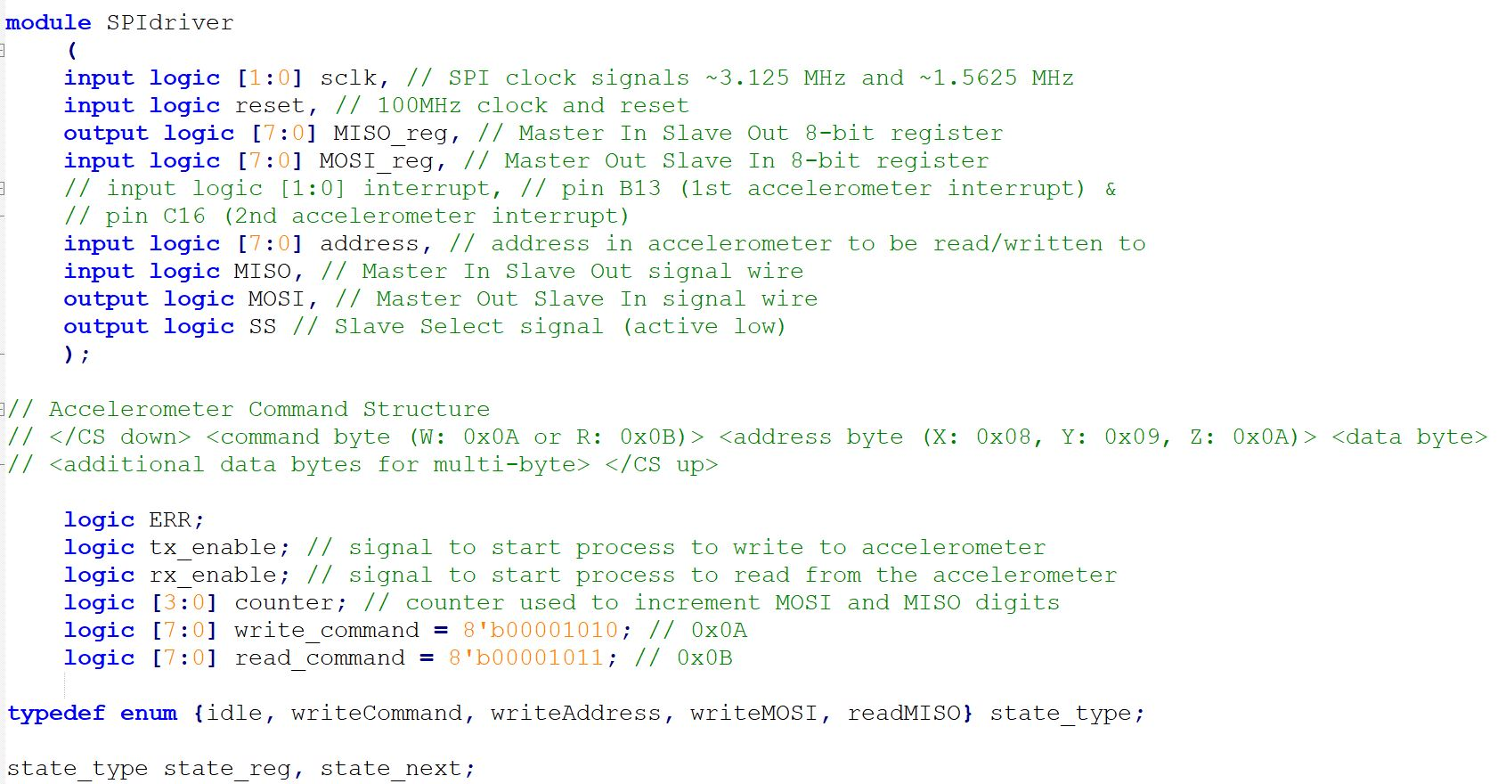
SPI Driver (1st iteration)

Slide 9
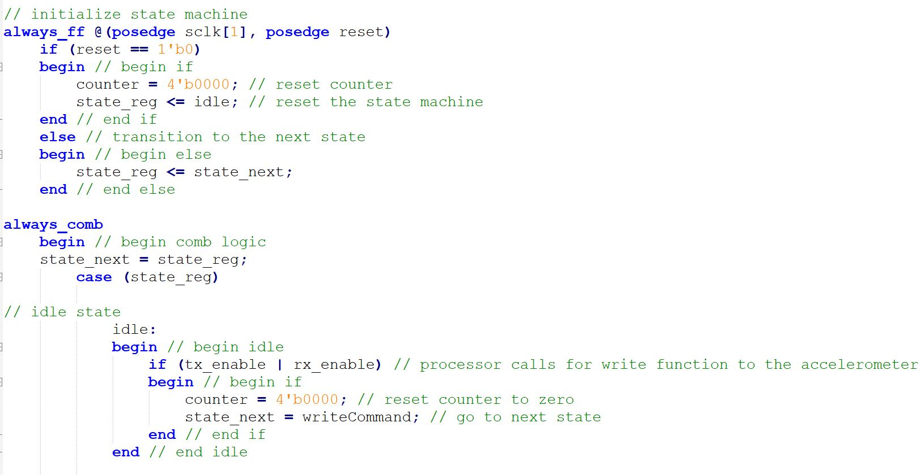
SPI Driver (1st iteration)

Slide 10
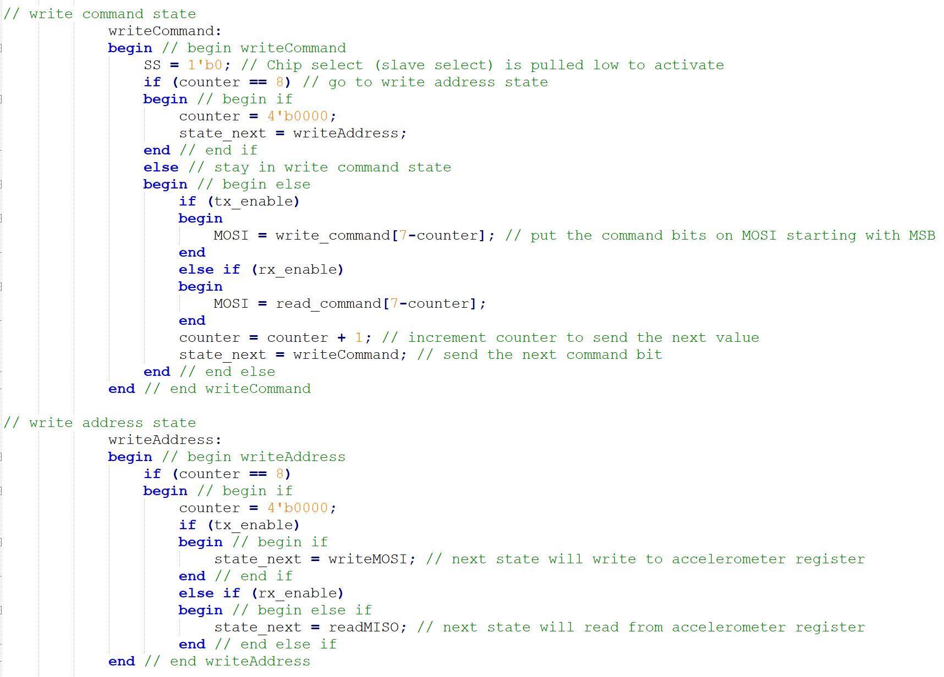
SPI Driver (1st iteration)

Slide 11
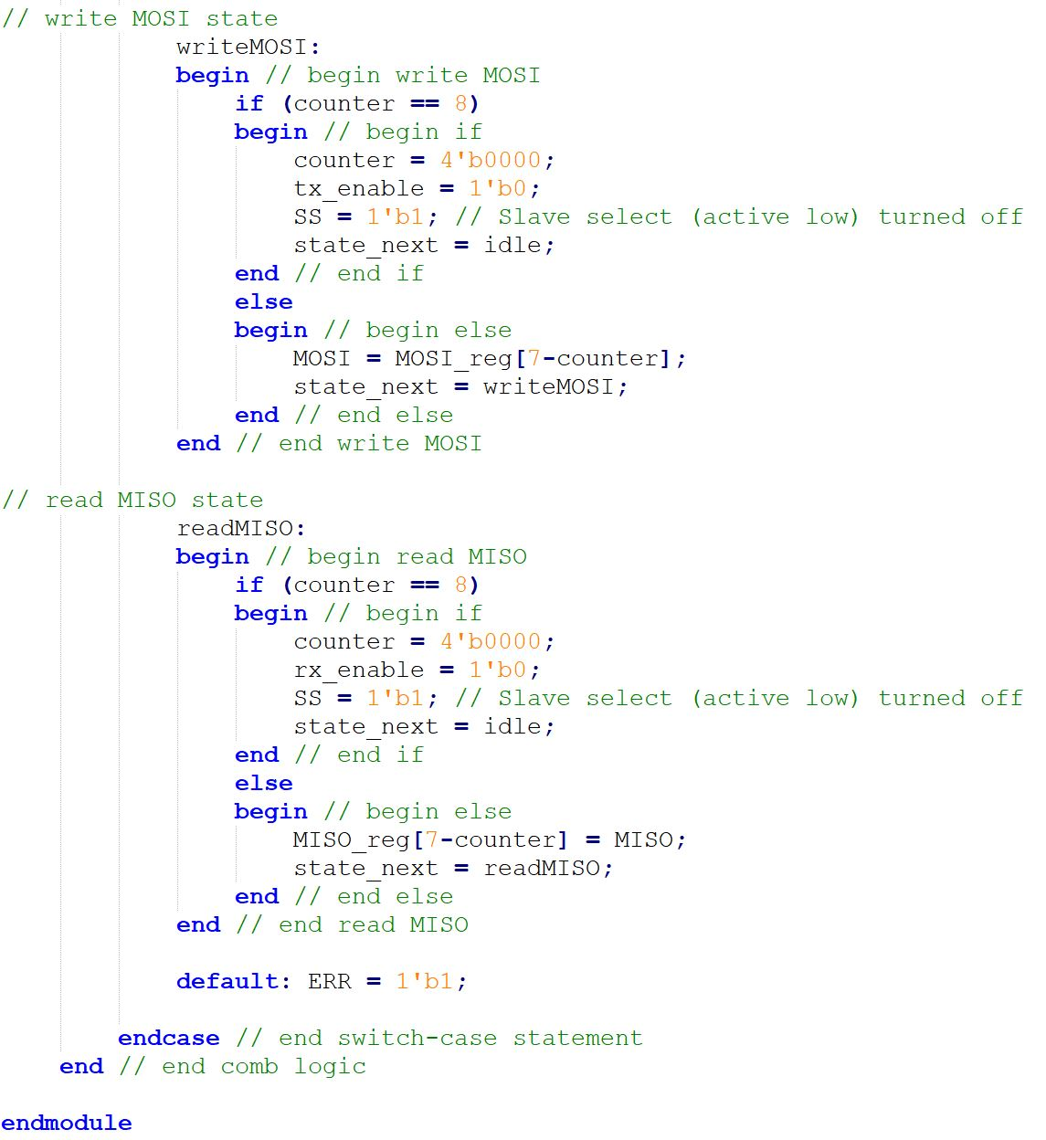
SPI Driver (1st iteration)

Slide 12
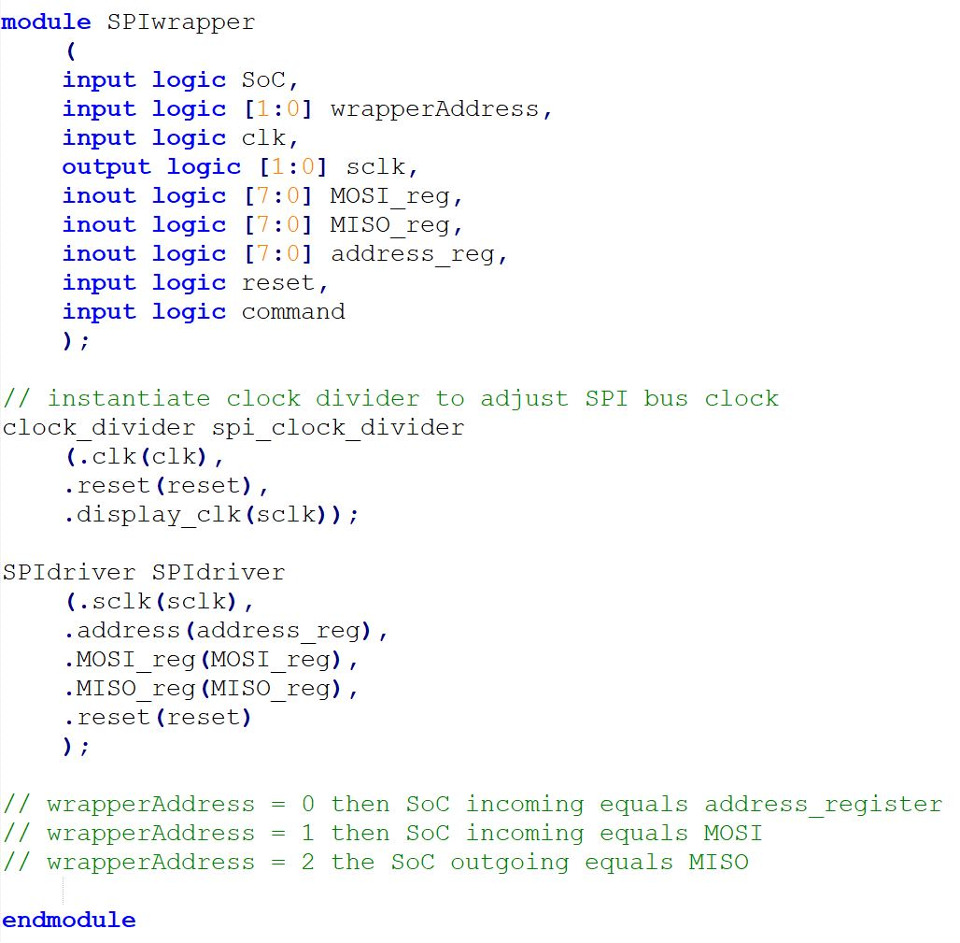
SPI Wrapper (1st iteration)

Slide 13
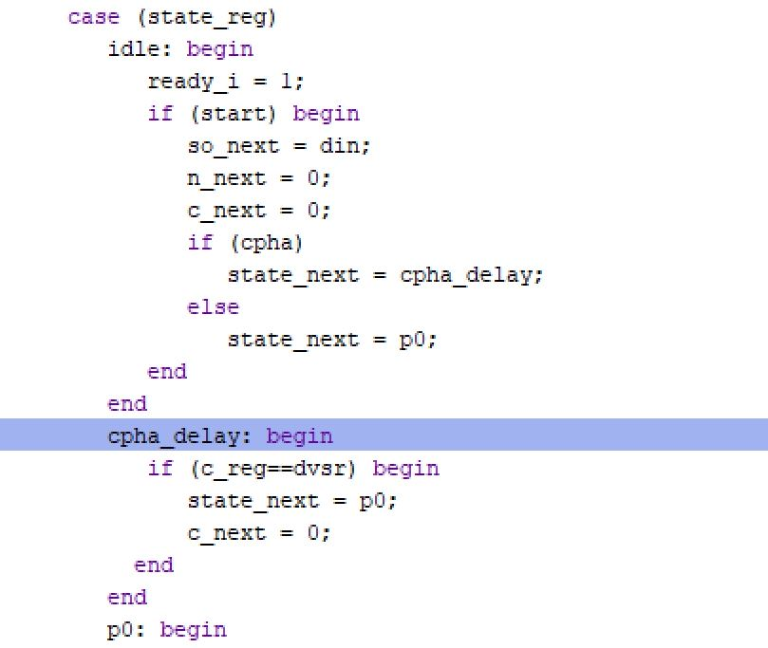
SPI Driver (Chu)
Notes:
Accounts for different CPOL and CPHA, but not different precisions from the accelerometer

Slide 14
Mistakes/Lessons Learned
State Machine Timing
If Statements (are the worst)
Reverse Engineering may not be helpful
Comment Everything

Slide 15
Future Developments
Add parameter for more precision from accelerometer
Find board that includes gyroscope
Display g force

Slide 16
Questions?

